Slide 1
System Software
Dr. Charles R. Severance
online.dr-chuck.com

Slide 2
Outline
Memory Controller
RAM, ROM, EPROM / Keyboard / Screen
BIOS
Operating System
Compiler
Interpreter

Slide 3
From a CPU to a Computer

Slide 4

What
Next?
Generic
Computer
Software
Input
and Output
Devices
Central
Processing
Unit
Secondary
Memory
11100010
11101000
Main
Memory
Python for Everybody
Chapter 1
Slide 19
Machine
Language
Notes:
This slide is a block diagram of a computer showing a central processing unit connected to main memory. Software is loaded into the main memory. The software can also interact with input / output devices and secondary memory for long-term storage.

Slide 5
ROM
Keyboard
Central
Processing
Unit
Memory
Logic
Screen
RAM
Sound
I/O
Storage
ROM – Read Only Memory
RAM _ Random Access Memory
Network
Notes:
This slide is a block diagram of a computer showing a central processing unit connected to main memory. Software is loaded into the main memory. The software can also interact with input / output devices and secondary memory for long-term storage.

Slide 6
AI: Please show me the address map of the Apple 2
1981
+----------------------+ FFFF ┐
| Monitor ROM | │
| (last 2 KB) | │
+----------------------+ F800 │
| Applesoft BASIC ROM | │
| (8 KB) | │
+----------------------+ E000 │
| Integer BASIC ROM | │
| (early models only) | │
+----------------------+ D000 │
| I/O & "Soft" Switches| │
| C000–C0FF | │
| Expansion Slot ROM | │
| C100–C7FF (per slot) │
+----------------------+ C000 │
| Free RAM / Expansion | │
| varies by model | │
+----------------------+ A000 │
+----------------------+ A000 │
| Hi-Res Page 2 | │
| Graphics (8 KB) | │
+----------------------+ 9800 │
| Hi-Res Page 1 | │
| Graphics (8 KB) | │
+----------------------+ 8000 │ Graphics
| Text Page 2 | │
+----------------------+ 0400 │
| Text Page 1 | │ Video RAM
+----------------------+ 0200 │
| Zero Page & Stack | │
| | │
+----------------------+ 0000 ┘

Slide 7
AI: How do I make a click on the Apple II in 6502 Assembly?
Reading memory location $C030 toggles the speaker state
LDA $C030 ; One toggle = click

Slide 8
AI: How do I read the current pressed key on the apple II in 6502 assembly?
When a key is pressed, location $C000 holds the ASCII code with bit 7 set.
You must read $C010 after handling the key — this resets the “key ready” flag so the next keypress can be detected.
If bit 7 of $C000 is not set, no key is waiting.
GETKEY:
LDA $C000 ; Read keyboard
BMI GOTKEY ; If bit 7 = 1 → key is ready
BPL GETKEY ; Loop until key arrives
GOTKEY:
LDA $C000 ; Read the actual ASCII value
AND #$7F ; Strip the high bit (keep ASCII only)
STA $C010 ; Reset keyboard strobe
RTS ; Return with key in A

Slide 9
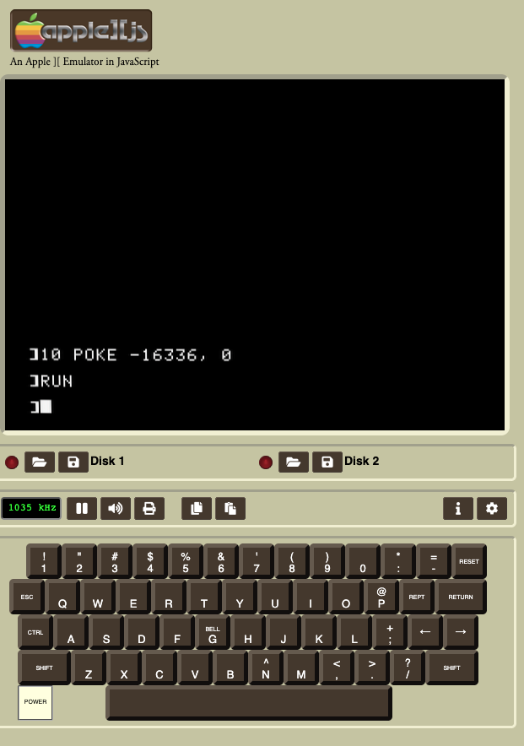
AI: How do I make a click sound in Apple Basic?
To make a click sound in AppleSoft BASIC, you just need to access the speaker soft-switch at memory location -16336 (which corresponds to $C030 in hex).
POKE -16336,0
https://www.scullinsteel.com/apple2/

Slide 10
AI: How do I make the whole screen white in the Apple 2 in 6502 Assembly?
; --- Set graphics + hi-res page 1 ---
LDA $C050 ; Graphics mode
LDA $C057 ; Hi-res mode
LDA $C054 ; Select Page 1
; --- Fill HGR Page 1 with $FF ---
LDA #$FF ; White pixel byte
LDY #0
LDX #0
FillLoop:
STA $2000,X ; Store byte in first page of hi-res memory
INX
BNE FillLoop ; Continue until X wraps to 0
INC FillLoop+2 ; (hack: increments high byte of address!)
BNE FillLoop ; Continue until reach $4000
RTS

Slide 11
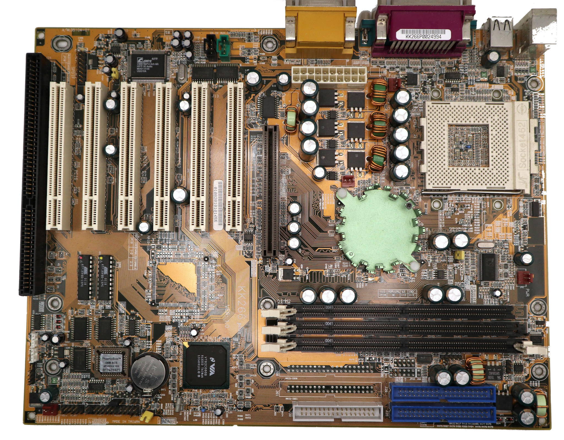
USB
Memory
Controller
North Bridge
CPU
Socket
Memory
Controller
South Bridge
RAM
Slots
ROM
BIOS
Disk
Connectors
2005

Slide 12
Read a Key on the IBM PC
AI: How do I read a key in x86 assembly using the original IBM PC BIOS?
; Check if key is waiting; ZF=1 if no key.
CHECKKEY:
MOV AH, 01h ; BIOS: Check Keyboard status (non-blocking)
INT 16h
JZ NO_KEY ; Zero flag set? No key available
; If key is available, read it:
MOV AH, 00h
INT 16h
NO_KEY:
RET

Slide 13
Operating Systems

Slide 14
What is an Operating System?
https://en.wikipedia.org/wiki/Timeline_of_operating_systems
An operating system (OS) is software that acts as an intermediary between computer hardware and the user or applications. It manages the computer’s resources and provides services so programs can run efficiently.
Modern: Windows, Linux, Mac OS/X
Early: MS-DOS, CPM, Apple DOS, VAX VMS, IBM CP/CMS, Commodore DOS, AmigaOS, Solaris, HP-UX …
AI: What would you choose as the top 20 operating systems from the 1970's to present excluding Window, Mac and Linux. Pick from various time periods.

Slide 15
Security in Early versus Modern Operating Systems
Early operating systems were a logical extension of ROM / BIOS
Utility code to make applications much easier to write
A file system with files and folders and space allocation on disk
A simple user interface
Ability to run multiple applications and switch between applications
Danger: System resources were vulnerable to malicious user applications
Modern operating systems make programs run in a “safe zone” so they usually cannot damage the operating system or other programs
Modern harmful programs typically affect files or use the network in bad ways, rather than directly invading the operating system.

Slide 16

Code with Flaws or Bad Intentions
In early computers an application could do anything that an operating system could do
Write an infinite loop and hang the operating system (spinning beach ball)
Delete or alter any data in memory or in a file
Patch the operating system or another application (install a virus)
Applications had to "voluntarily" cooperate in order not to harm the operating system or other programs
"Early" means Intel before i386 (1985), Motorola before MC68030 (1987) ARMv3 (1990)

Slide 17
How CPUs Protect Memory and Programs
Memory protection: Keeps programs from accidentally messing with each other’s data.
MMU (Memory Management Unit): A helper in the CPU that controls memory access.
User vs. Supervisor (Kernel) mode:
User mode: Where normal programs run.
Supervisor (Kernel) mode: Where the CPU runs the operating system safely.
Early CPUs: Had no protection at all.
Modern CPUs: Almost all have an MMU and separate user/kernel modes.

Slide 18
Operating Systems and Protection
Unprotected
Windows 3.1, 95, 98
MacOS 1-9 (2001)
Protected
Windows NT, 2000, and XP
Max OS 10.0
Linux from 1.0

Slide 19
When Linux Ran on Each CPU Family
CPU Family | First CPU Linux Ran On | Year Linux Support Began | Notes
Intel x86 | Intel 80386 | 1991 | Original platform for Linux 0.01. Required 32-bit + MMU + rings.
Motorola 68k | 68030 (practically) | 1992–1993 | Linux/68k port needed an MMU; stable on 68030-based Macs, Amigas, Atari TT.
ARM | ARM610 (Newton era) / early ARM7/ARM9 dev boards | 1994–1995 (first ports) | Early ARM Linux targeted ARM610-class chips with MMU; mainstream adoption on ARM9 later (~1998).

Slide 20

Is it "turtles all the way down"?
Linux was built on i386 in 1992 and for the ARM in 1994
Mac OS 10 was built on NeXTSTEP, which was built on the BSD Unix platform (2001)
Windows 11 has a feature called Windows Subsystem for Linux (WSL) that allows running Linux as a guest operating system with hardware and kernel emulation (2019)
Notes:
https://bellard.org/jslinux/
https://vfsync.org

Slide 21
Programming Software
Compiler
C / RUST / Java (*)
Interpreter
Python / PHP / Java (*)
Emulator
Virtualization

Slide 22
Compiler

Slide 23
Compiler Phases

Slide 24
Python Runtime
Python
Kind of Hybrid for performance reasons
__pycache__ ( byte code)

Slide 25
Java Runtime
Traditional compiler to "byte code"
javac hello.java -> hello.class
Java virtual machine (JVM) runtime – byte code emulator
java hello.class
Just in time (JIT) compiler (a.k.a. Hotspot compiler)
JVM supports multiple languages
Scala …

Slide 26
Interpreter

Slide 27
Virtualization

Slide 28
Virtualization
Modern CPUs have support for virtualization
CP/CMS
Parallels on Mac and Windows
Vmware
Docker
VirtualBox (Oracle)

Slide 29
Summary
TBD

Slide 30
Acknowledgements / Contributions
These slides are Copyright 2025- Charles R. Severance (online.dr-chuck.com) as part of www.ca4e.com and made available under a Creative Commons Attribution 4.0 License. Please maintain this last slide in all copies of the document to comply with the attribution requirements of the license. If you make a change, feel free to add your name and organization to the list of contributors on this page as you republish the materials.
Initial Development: Charles Severance, University of Michigan School of Information
Insert new Contributors and Translators here including names and dates
Continue new Contributors and Translators here

